Slide 1

Wireframing &
Adaptability
roberto.figlie@phd.unipi.it

Slide 2
Lesson Outline
Wireframing
Adaptability
Responsive design
Accessibility
Wireflows

Slide 3
What is a Wireframe?

Slide 4
Why wireframes?
Suppose you have a wonderful idea for a product (a website, an app, a video game, anything).
If you are not capable to convey that idea to other people, everyone will do what they think it is the best. This means that everyone will go in different directions!
Unless you are working alone, and even in that case you may think to have a precise idea of the design you are thinking of, but in fact it is not.

Slide 5

Why wireframes?
What is the best way to clarify a thought process that humans discovered during the past millennia?
Start with pen and paper!

Slide 6
What is a wireframe?
Coming back to developing a product:
Wireframes are blueprints that help communication between designers and programmers about the structure of the website or app they are developing.
Wireframes represent the beginning of putting information architecture into practice.

Slide 7
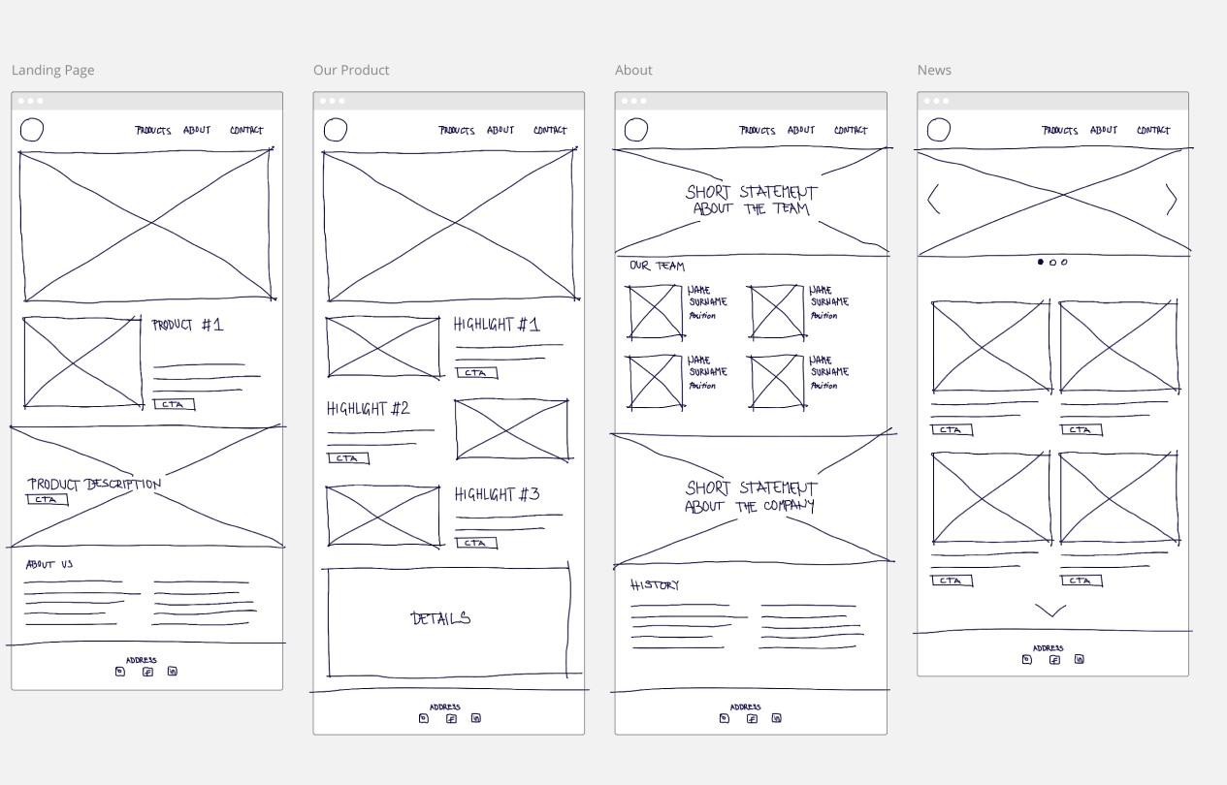
What is a wireframe?
The activity of wireframing indicates the process of creating basic sketches of a website or application's interface to demonstrate its structure and layout.
https://www.interaction-design.org/literature/topics/wireframing

Slide 8


What is a wireframe?
What can?
Give its first visual shape to an information architecture.
Encourage discussion within the team.
Determine the functionalities of the UI.
What cannot?
Give the feeling of the UI final look.
Provide working functionalities.
Guarantee you are understood :)

Slide 9
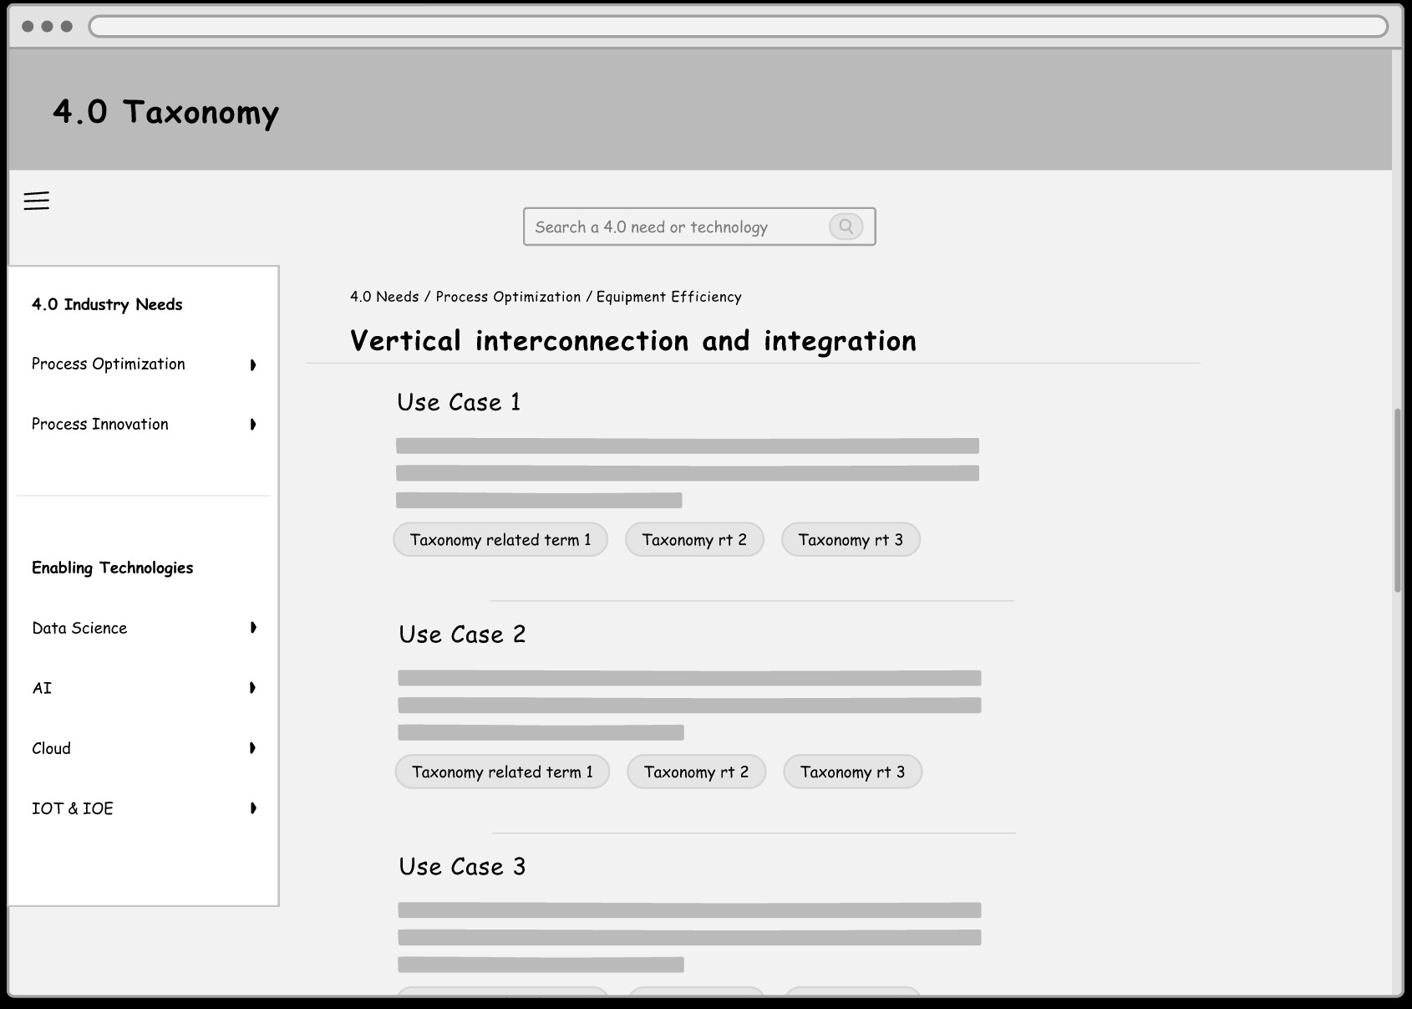
What is a wireframe?
Example:
No colors
No images
Basic fonts
https://www.usability.gov/how-to-and-tools/methods/wireframing.html

Slide 10
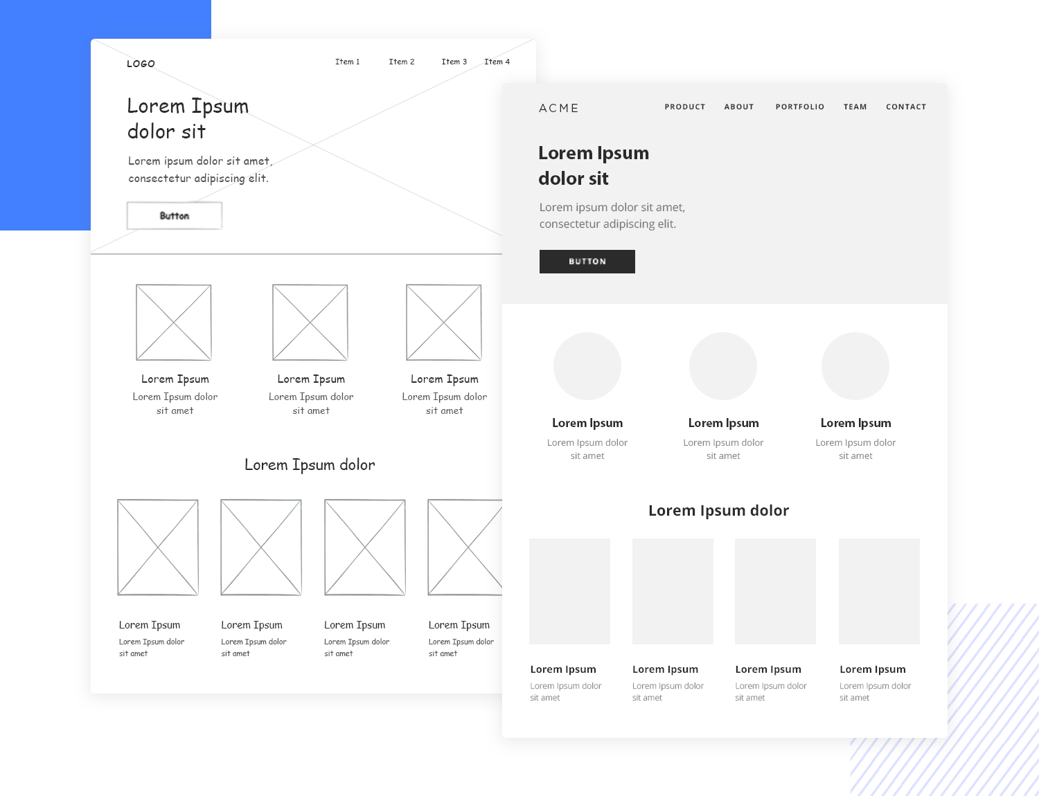
Types of wireframes
Low-fidelity Wireframes:
Simple sketches of the interface, focusing on the structure and layout.
High-fidelity Wireframes:
Detailed representation of the interface with basic typography, icons and documentation details.
https://www.justinmind.com/wireframe/low-fidelity-vs-high-fidelity-wireframing-is-paper-dead

Slide 11
Adaptability, Responsive design & Accessibility

Slide 12
The role of context
Context plays an important role in UX Design.
Examples of how context can affect user behavior and preferences:
A user browsing a website on a mobile device may have different needs and behaviors than a user on a desktop computer.
A user with an high degree of knowledge in the domain of a website may have different needs and preferences than a user that does not have it.
Context can include a wide range of factors such as user demographics, device, location, culture, and accessibility needs.
So it is important to conduct user research and testing to understand the different contexts in which users will interact with the design.

Slide 13
Adaptability
Remember: you are not designing for yourself!
This means two things:
Others think differently from you (subjective and/or cultural differences, etc.).
Others have different needs and capabilities (different skills, physical capabilities, etc.).

Slide 14
Adaptability
Adaptability in UX design is an umbrella term and refers to the ability of a design to adjust and respond to different user needs, contexts, skills, and preferences.
Usually, it covers the notions of:
Responsive design
Accessibility

Slide 15
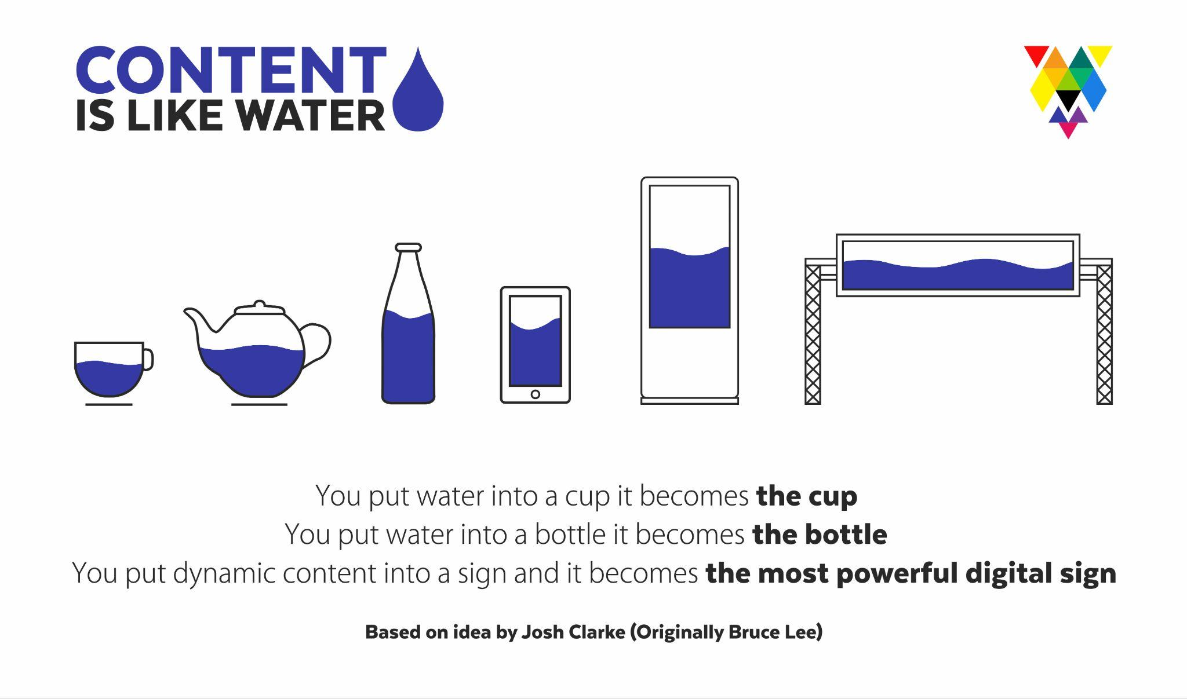
Responsive Design
With the explosion of the device market came a fragmentation of the different display sizes available.
Moreover, each device has different layouts, standards, icons etc.
https://www.interaction-design.org/literature/topics/responsive-design

Slide 16
Responsive Design
With the increasing use of mobile devices to access the internet, it is crucial to ensure that websites are easily readable and usable on a wide range of devices.
Responsive design comes to help as a method of designing and coding web pages, apps, etc., to adapt to the size and resolution of different devices.
RD allows users to have a consistent experience whether they are accessing the website on a desktop, tablet, or mobile device. It also makes it easier for businesses to maintain and update their website, as they only need to maintain one version of the site.

Slide 17
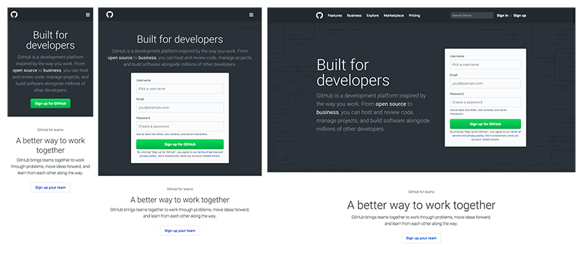
Responsive design: Techniques
Flexible grid: A flexible grid allows elements to adjust to the size of the screen. This can be achieved in many ways, depending on the framework you are using.

Slide 18
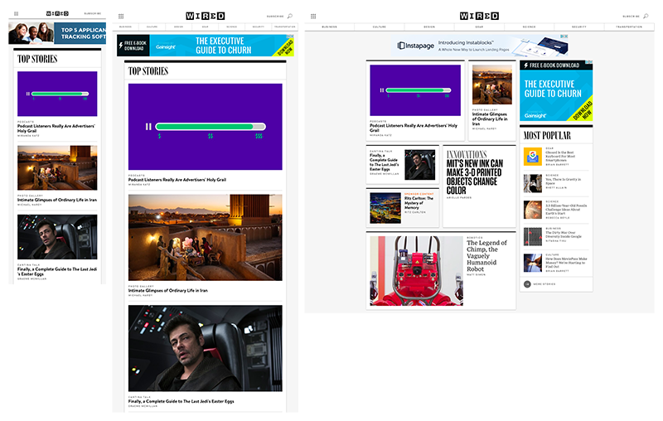
Responsive design: Techniques
Flexible images: Make images scale and adjust to the size of the screen.

Slide 19
Responsive design: Techniques
Media queries & breakpoints: Allows different styles to be applied based on the characteristics of the device.

Slide 20
Responsive design: Mobile first
Mobile-first design is a design philosophy that prioritizes mobile over desktop. This approach ensures that the mobile experience is optimized before designing for larger screens.
By designing for mobile first, designers ensure that the most important content and functionality is easily accessible on small screens, and that the site is easy to navigate with touch-based controls.
This approach also helps to ensure that the site loads quickly on mobile devices with slower internet connections. Additionally, mobile-first design can help improve search engine optimization (SEO) by making sure the site is optimized for smaller screens.

Slide 21
Responsive design: Mobile first
Mobile-first allows for a “progress advancement” design, meaning that the design starts from the minimum functions and basic interactions (usually found in smartphones), then building up adding more interactions and effects (usually found in desktop).
This is opposed to “graceful degradation”, that is starting with a complete design based on advanced devices, then cutting features to accommodate for smaller and less capable devices.
Examples?

Slide 22
Responsive design: other best practices
Keep it simple: Avoid using complex layouts and keep the design minimalistic.
Prioritize the content: The content should be the most important element on the page, and it should be easily readable on all devices.
Design for touch: Make sure buttons and links are large enough to be easily tapped with a finger.
Optimize for load time: Large images and other heavy elements can slow down a site's load time, especially on mobile devices. Optimizing these elements can improve the user experience.
Test, test, test: Test the website on a variety of devices to ensure that it looks and functions correctly (possibly outside your “laboratory”).

Slide 23
Adaptive design
Other then responsive design there is another way to make the interface automatically adaptable to the user: adaptive design.
Responsive design is a type of adaptation to the device in a fluid and flexible way.
Adaptive design, usually stands for creating different layouts for each device. It is more expensive, but sometimes is better (e.g., big companies that have to make their website better for mobile, without spending time in retrofitting the desktop version)

Slide 24
Adaptive design
Design for adaptability
But there can be another way in which the system can be adaptive to the user.
The difference lays in the context of use:
depends on the device used
depends on the users themselves.
User
Device
Accessibility
Adaptive UX
Responsive design
Adaptive design

Slide 25

Adaptive UX
How can a system adapt to a user?
Having a basic information on the user (position through GPS, collaborative filtering, or even a user model from analytics) you can leverage them to adapt the the interface to the user.
In the case of collaborative filtering:
user A likes X and Y
and user B likes X
so user B may be interested in Y
https://www.amazon.science/the-history-of-amazons-recommendation-algorithm

Slide 26
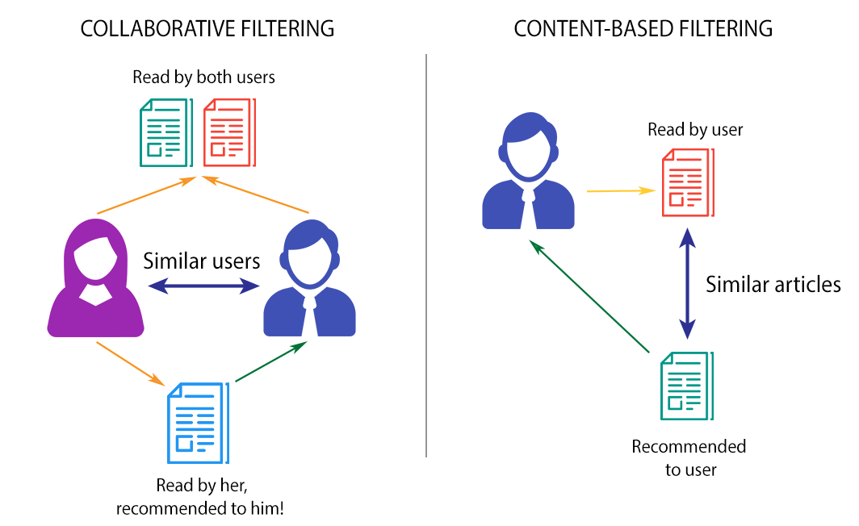
Adaptive UX
Together with collaborative filtering, content-based filtering is another possibility, but it is not based on the users, rather on the contents themselves.
Notes:
https://www.linkedin.com/pulse/amazons-recommendation-engine-secret-sauce-mario-gavira/

Slide 27
Accessibility
Accessibility in UXD is crucial because it ensures that all users can access and interact with the digital products, regardless of their abilities.
With the increasing use of digital products and services, it is essential that designers consider accessibility to make sure that everyone can use them.
https://www.interaction-design.org/literature/topics/accessibility

Slide 28
Accessibility
Remember:
Accessibility helps everyone!
Having a product that provides accessibility, is not only the right thing to do, but is more usable to the whole range of users.
Some examples?

Slide 29
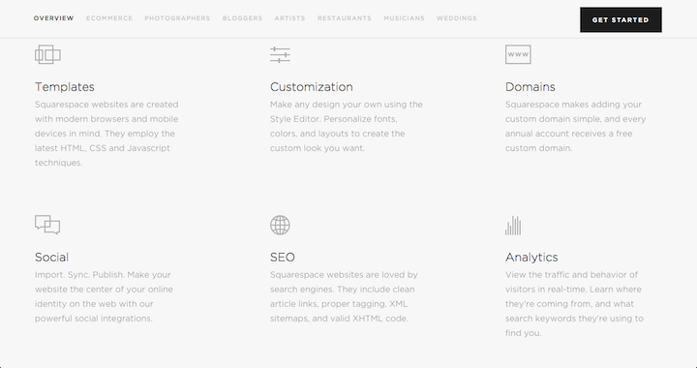
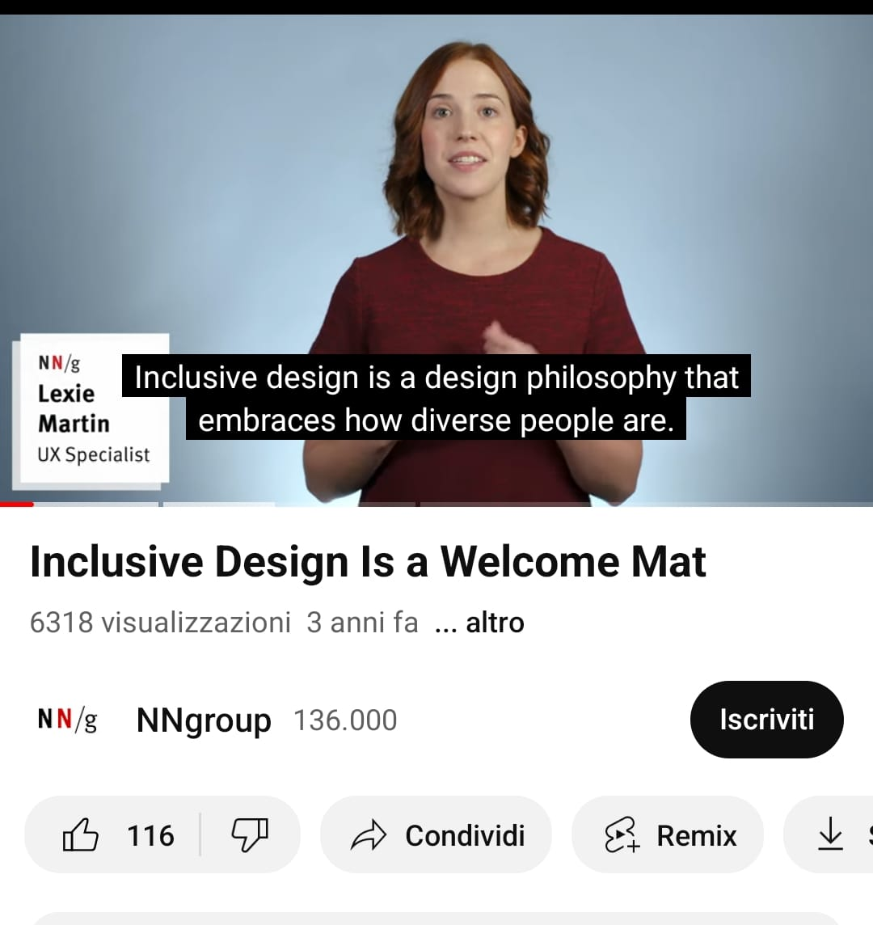
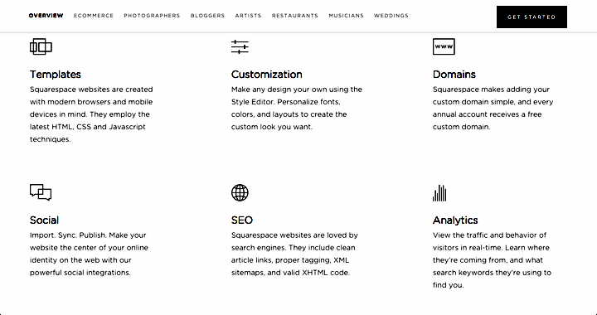
Accessibility
VS

Slide 30
Recap: How to design for adaptability?
You cannot think about adaptability only at the end of the design process.
Designing for adaptability should be integrated throughout the design process, starting from the research phase to the testing and implementation phase.
Especially when you start to build wireframes, you already should know for whom you are designing and what are their needs.

Slide 31


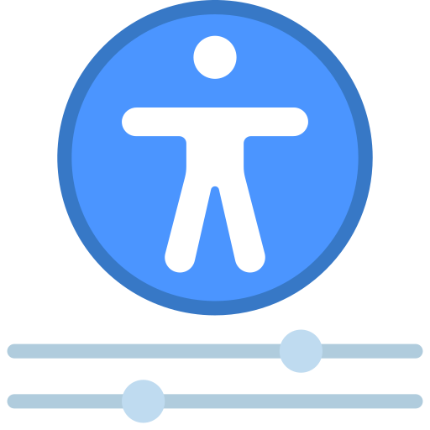

Recap: How to design for adaptability?
User research: understanding the user needs, behaviors and preferences in different contexts.
Responsive design: creating designs that adapt to different screen sizes and devices.
Accessibility: ensuring that the design is usable for people with disabilities.
Testing: validating the design in different contexts and making adjustments accordingly.

Slide 32
From wireframes to wireflows

Slide 33
User flows
We said that wireframes are used to visually describe the user interface by means of static blueprints. But the real actions that the user will have on that interface are not static!
This is why we can use user flows.
User flows help to describe the possible actions available to the a particular user in our interface. It helps to map out all the possible steps and the movement of the user in our app/website.
https://careerfoundry.com/en/blog/ux-design/what-are-user-flows/#where-do-user-flows-fit-into-the-ux-design-process

Slide 34
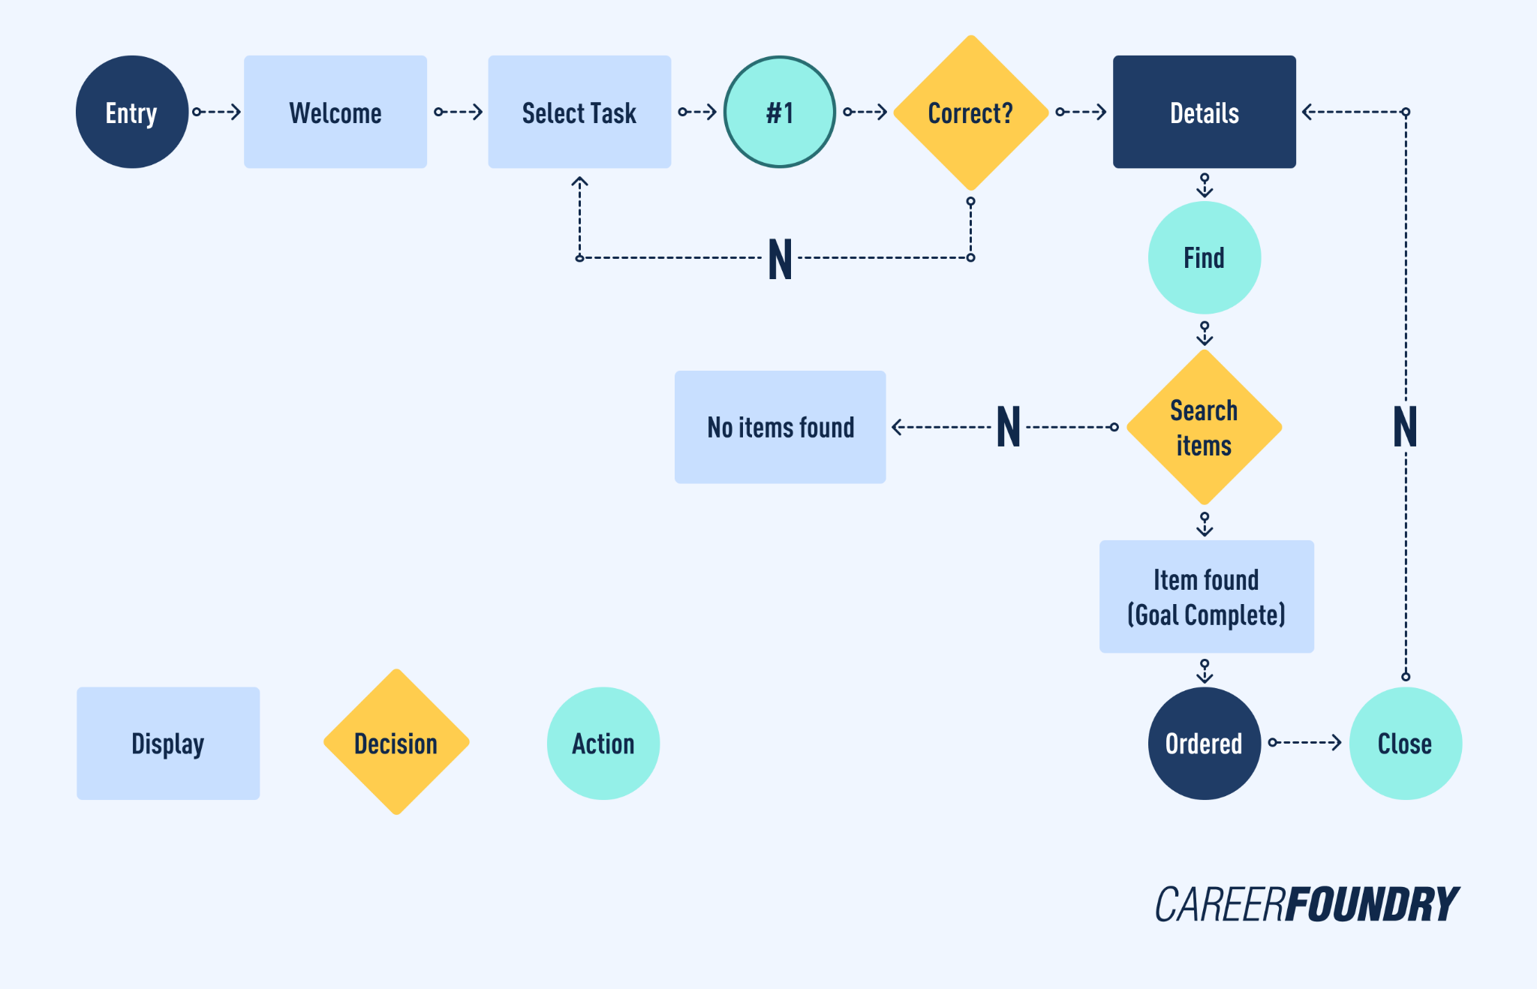
User flows: flowchart
When defining the flow the better way is to start from the personas, the requirements, scenarios and (even better) the user journey.
Thinking about the possible touchpoints that the user will have with the system we can define an abstract flowchart.

Slide 35
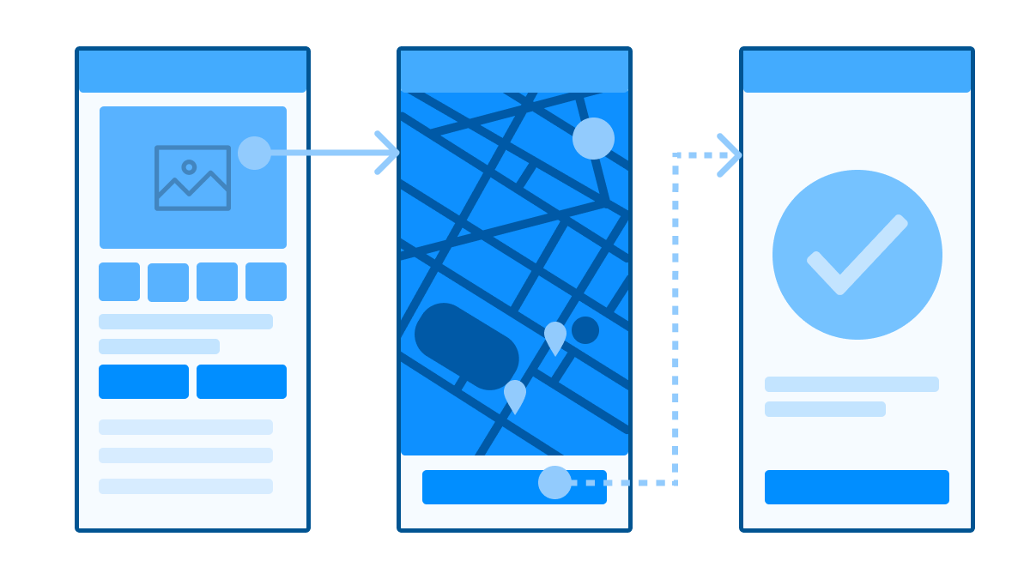
User flows: wireflows
Wireflows further express a flowchart by using wireframes instead of abstract descriptions.

Slide 36
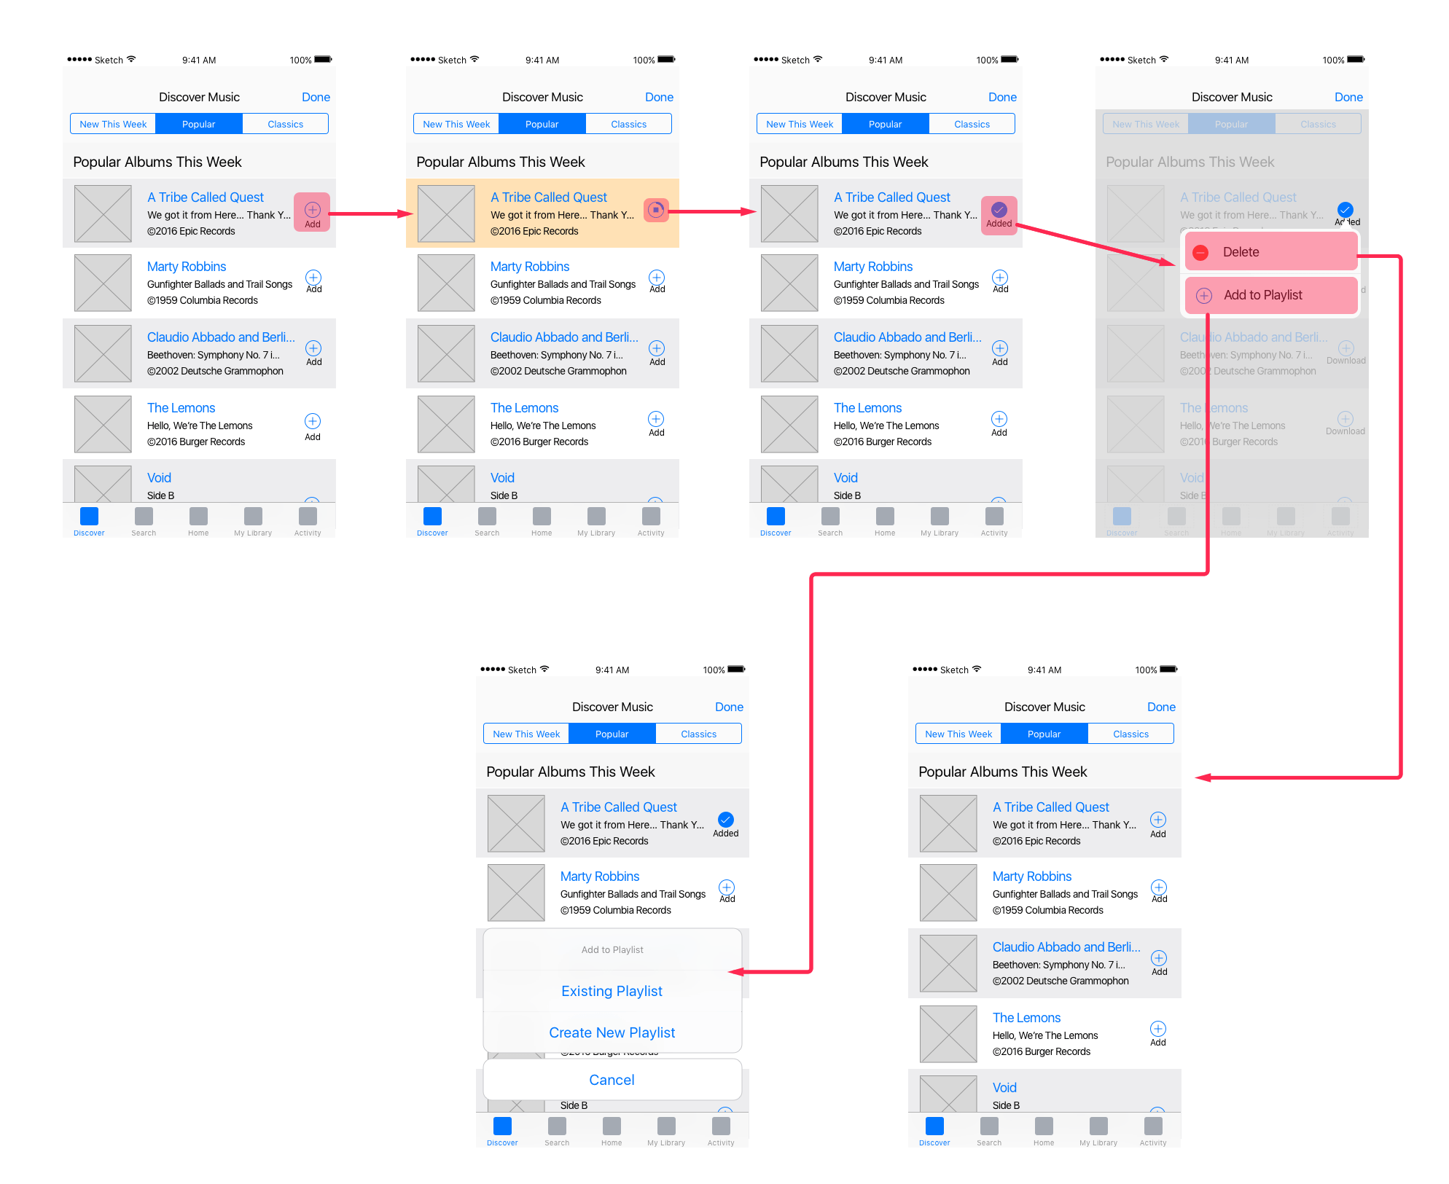
User flows and wireflows
A wireflow can be also used to describe a particular user flow.
When you take the course of action that a specific persona can take in your system and describe it through a particular flow chart you have a user flow.
A user flow expressed with the use of wireframes, as a wireflow, narrates better the use of the interface.

Slide 37
Mockups

Slide 38
Mockups
A mockup is a high-fidelity representation of the product that includes more visual detail and design elements than a wireframe: it is a more polished and refined version and it is used to test and refine the look and feel.
A realistic visual design that resembles what the new product or functionality will look like.

Slide 39
Mockups
Creating a mockup involves adding visual details and design elements to a wireframe, such as typography, color schemes, and images. Mockups can be created only digitally using design software, such as Sketch, Adobe XD (or Photoshop, just like the good old times), or Figma.
So, mockups can be used to refine and showcase visual design elements, from the placement of images and icons to the overall style and branding of a product or service. But is essential to note that while mockups may resemble the final product, they lack the functionality required to perform meaningful testing or gather insightful feedback. This is because mockups are static representations of the design and lack the interactive elements that are necessary for usability testing.

Slide 40
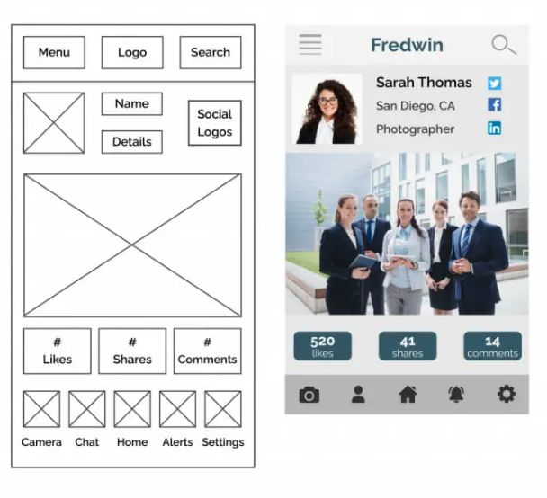
Wireframes vs Mockups

Slide 41
Mockups
When and why?
UX/UI teams commonly rely on mockups during the design process to showcase their ideas to stakeholders and clients. These mockups serve as visual aids that help UX professionals communicate their design concepts and features more effectively. In addition, mockups are helpful for certain types of usability studies where feedback is needed on the overall look and feel of the design (5-seconds test, first-click test).

